Slide 1
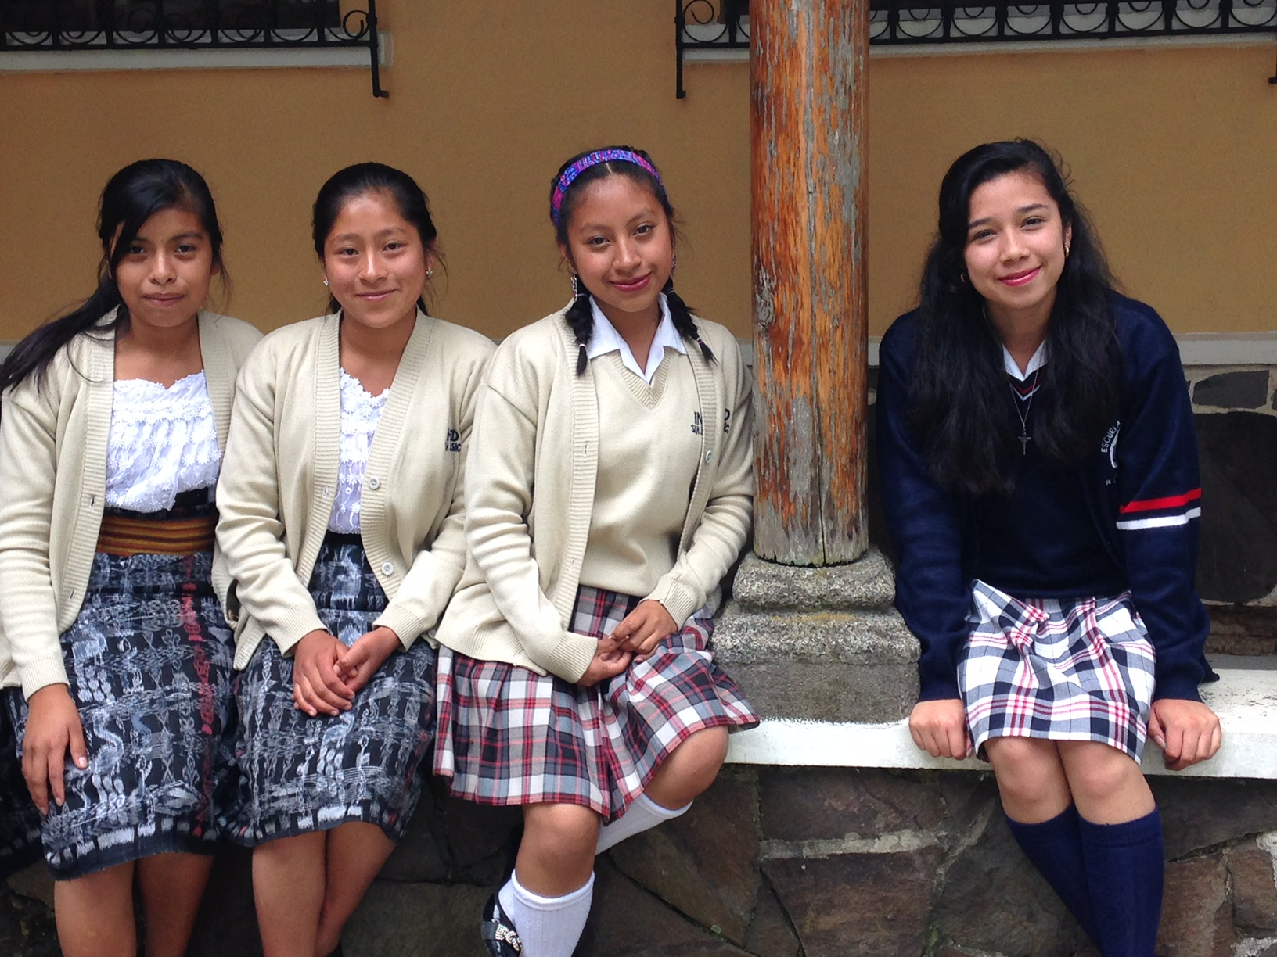
FRIENDS OF GUATEMALA Membership Meeting June 19, 2021
JUNETEENTH
Commemorating the emancipation of enslaved African Americans throughout the former Confederate States of America, outside Native American lands.

Slide 2
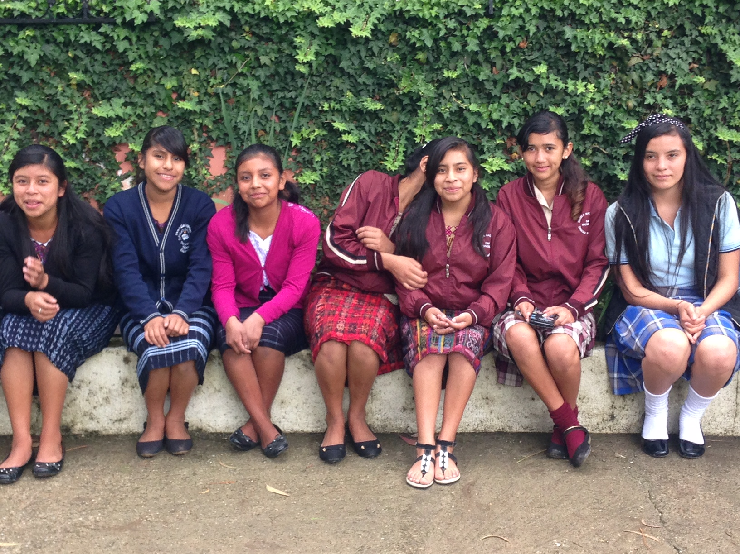
Agenda
Welcome, Introductions
Mission and Accomplishments
Scholarship Projects
Challenges
Current situation in Guatemala
Questions and open forum

Slide 3
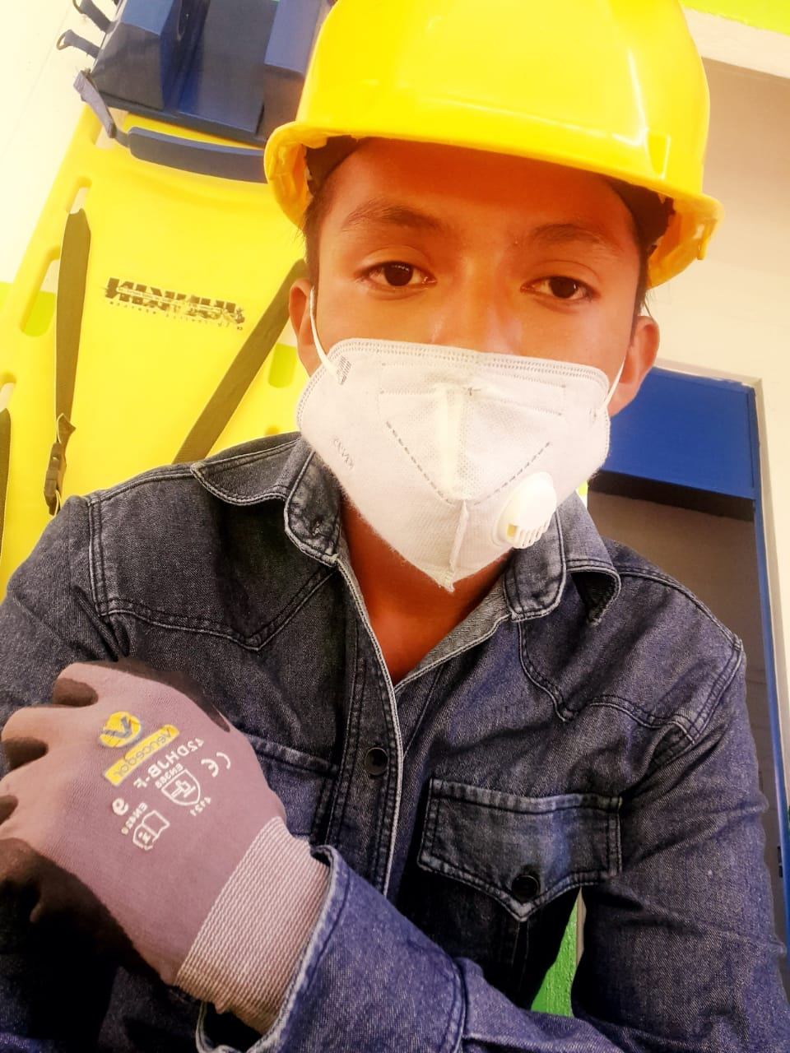
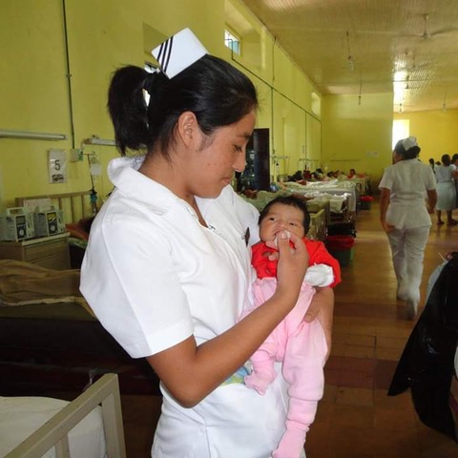
Mission
“I want to emphasize that the goal of our work is to help Guatemalans find hope at home.”
–Vice President Harris, 6/7/2021
That’s exactly what FOG has been doing, since 1989.
Empowering young people and their communities by promoting education through scholarships and other related projects
Non-profit organization, incorporated in the District of Columbia and tax-exempt under Section 501(c)3 of the Internal Revenue code
Member of the National Peace Corps Association

Slide 4
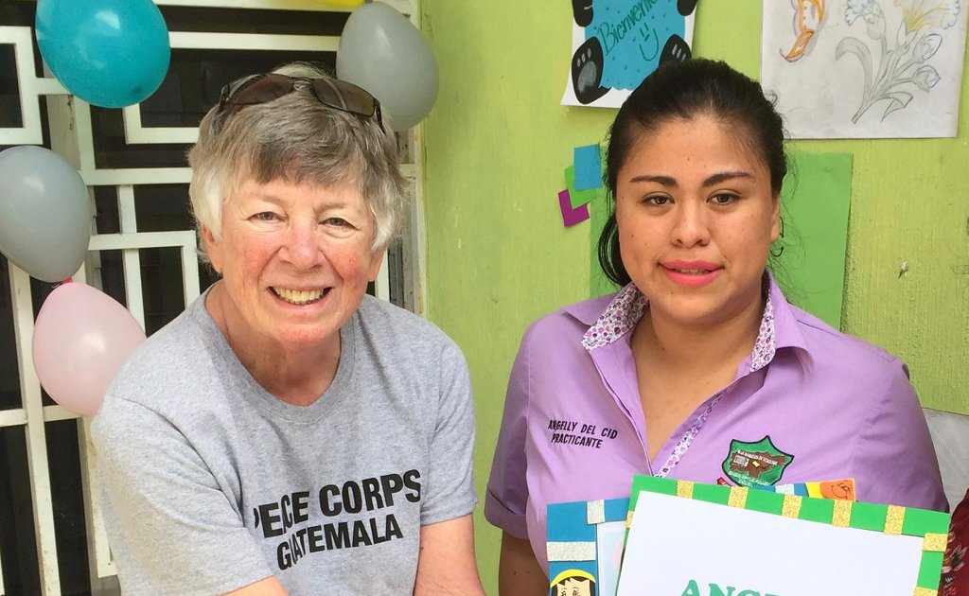
2020 Accomplishments
Category I Scholarships
Funded by membership donations
42 in 2020
Category II Scholarships
Funded by current and former volunteers
111 in 2020
Other 2020 projects
Fundraised $9000 for COVID relief
Supported evacuated volunteers
Egg production project Santa Cruz del Quiche
Donation to NPCA for ERPCVs
Revitalized Board, adding 3 new members
Updated by-laws (first time since 1989)

Slide 5
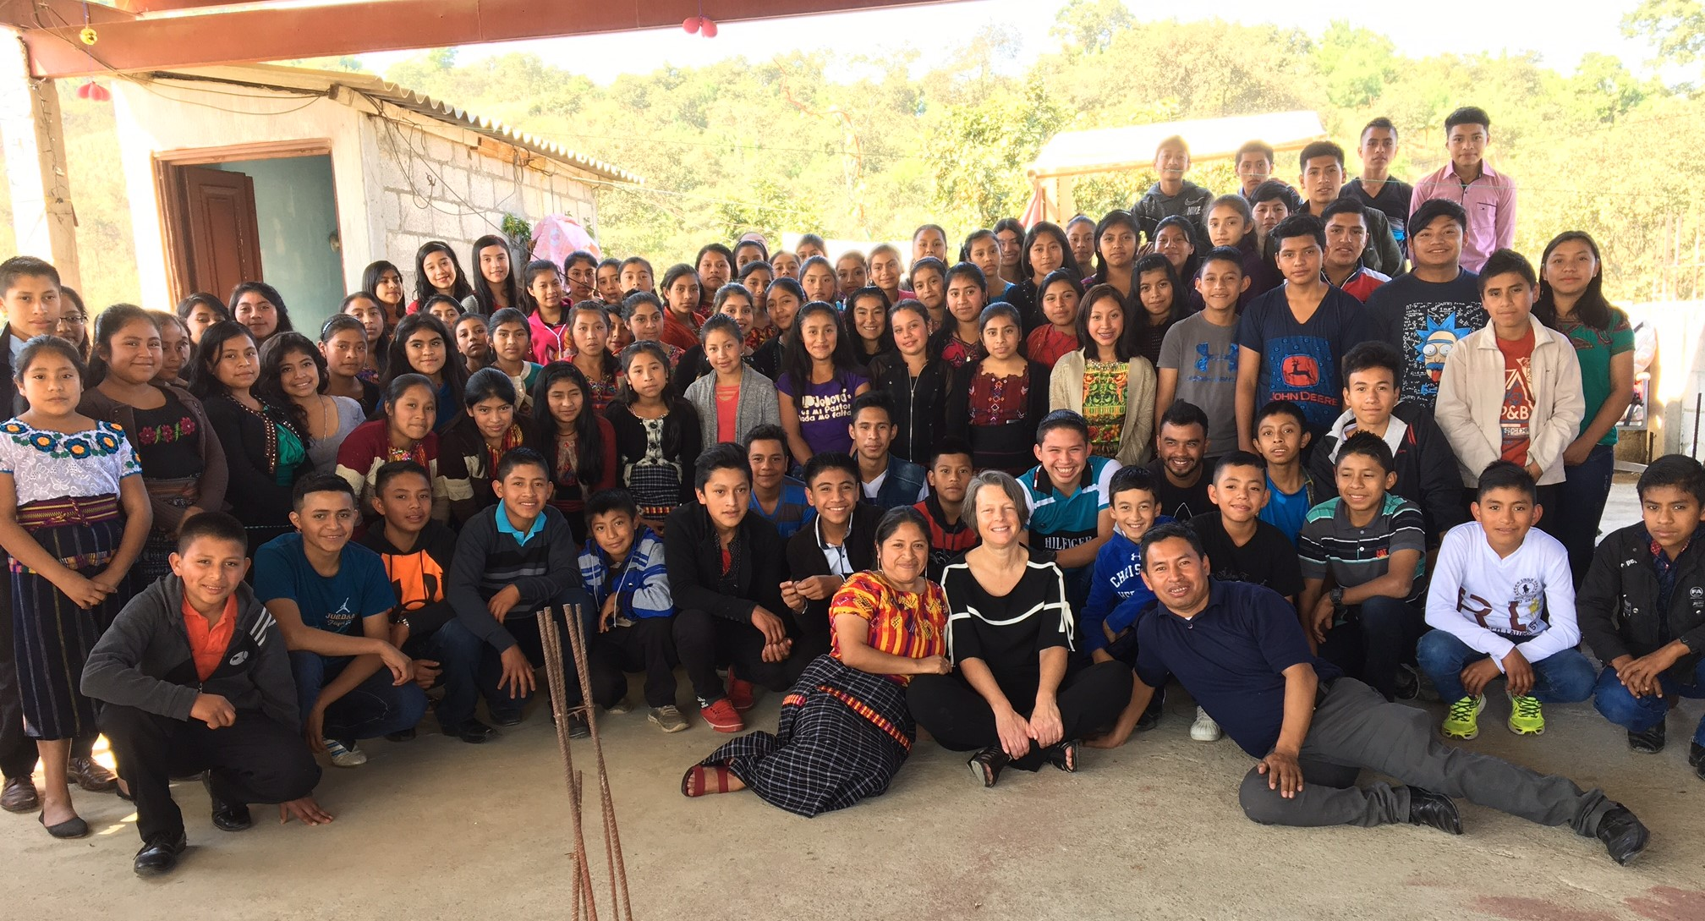
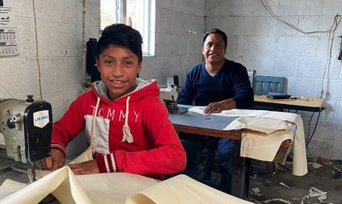
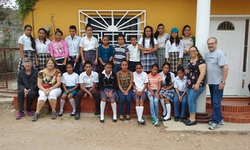
Ongoing scholarship projects
SAN JUAN SACATEPEQUEZ
Started in 2010, with 7 students
Currently 80 students
MIL MILAGROS
Based in Solola
Currently 11 students
SANSARE
El Progreso
Currently 44 students

Slide 6
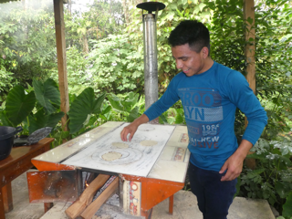
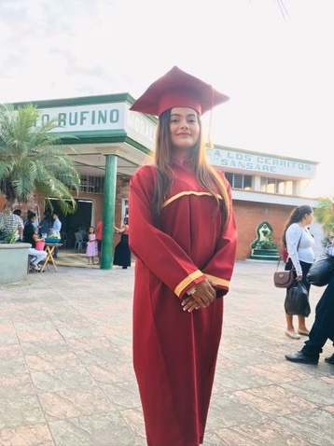
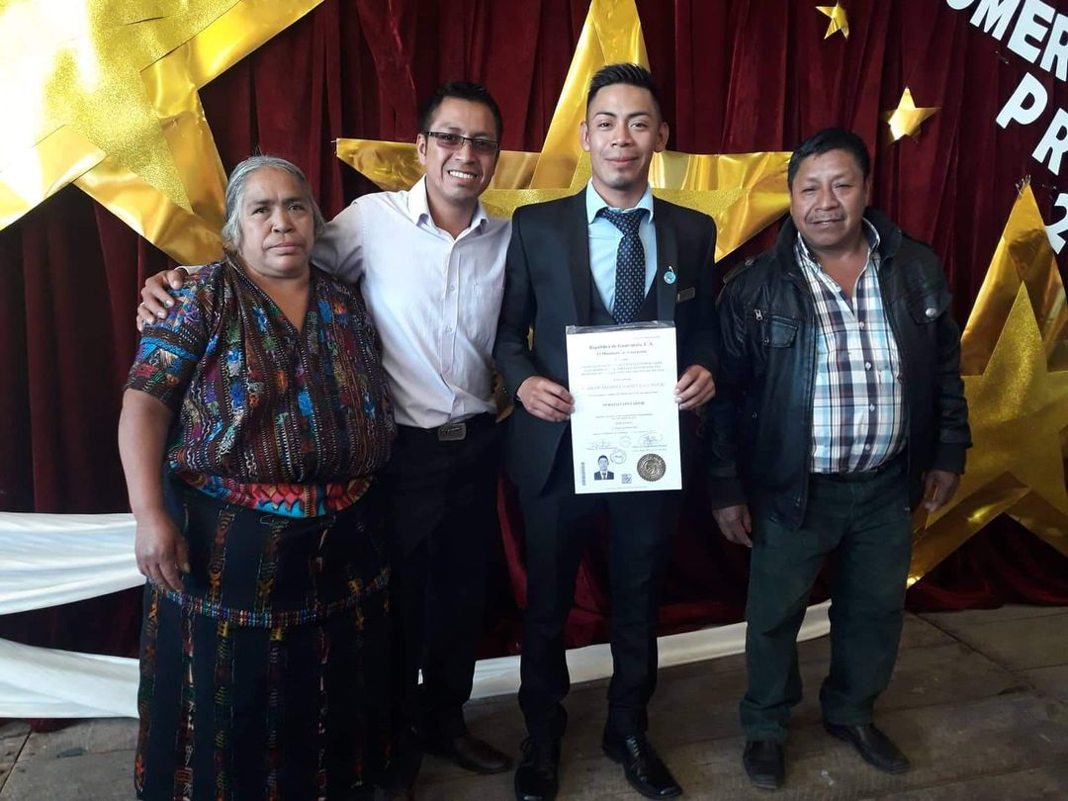
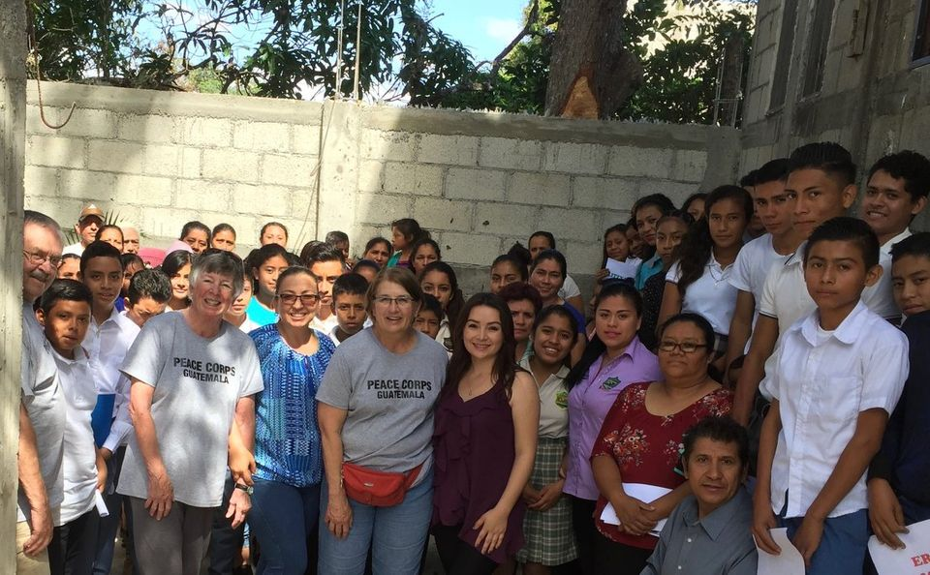
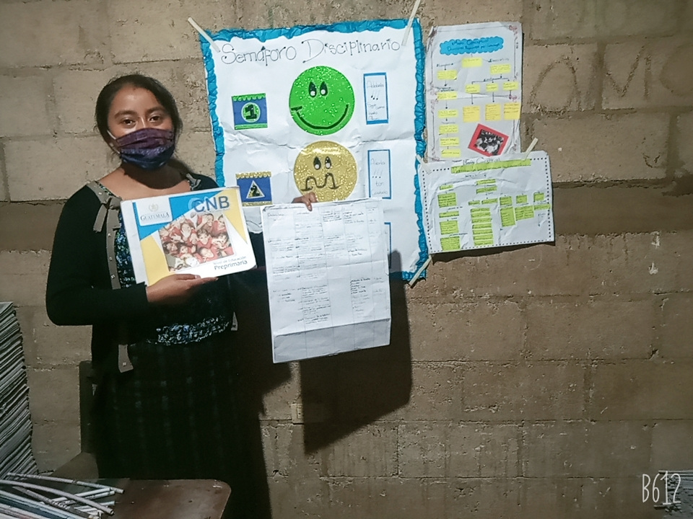
Support … Perseverance ... Success

Slide 7
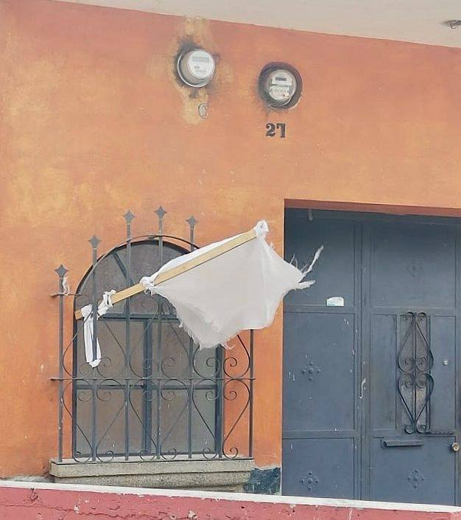
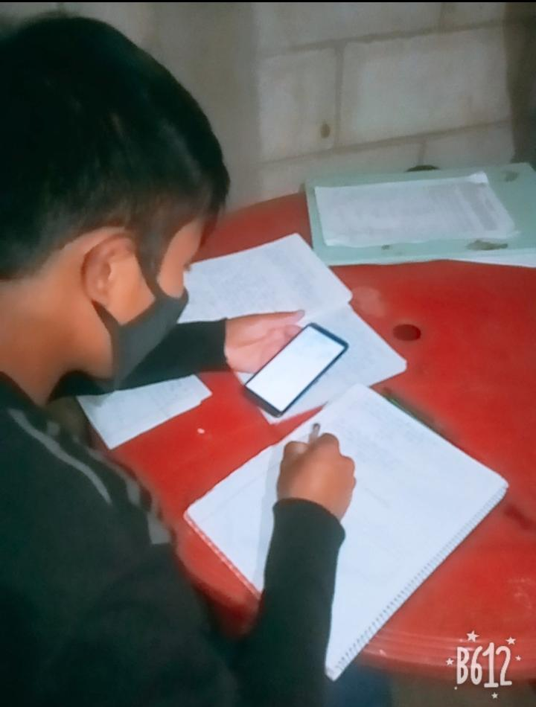
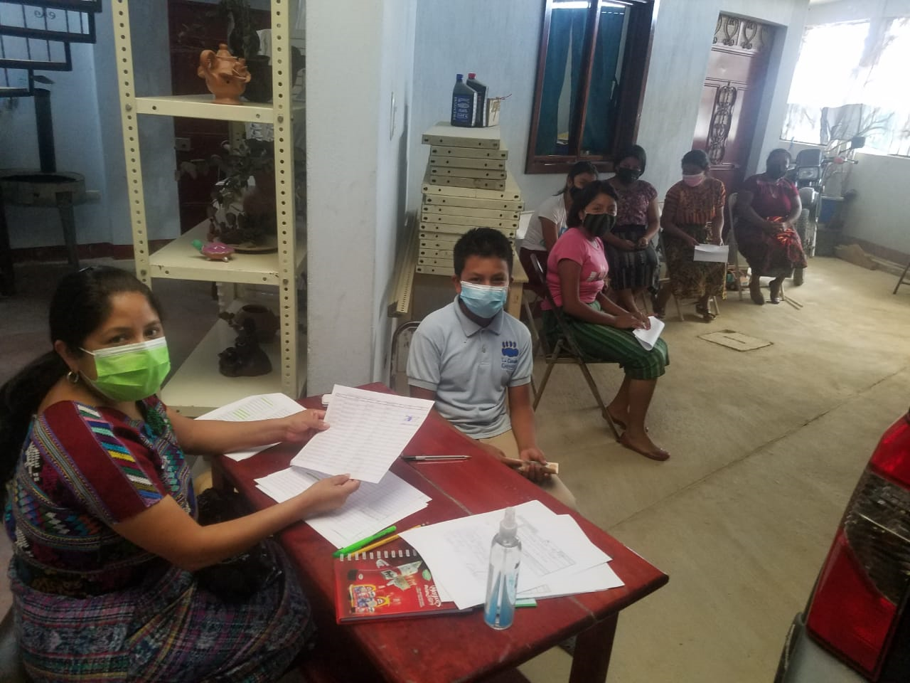
Challenges
COVID-19 vaccine—so far only for elderly, not available to most students
Due to evacuation, volunteers are not in sites to mentor students, apply for and administer scholarships
Schools not reliably open
Technology lagging to support remote learning—need laptops, cell phones
Weak or lack of internet service in aldeas
Expenses remain high, for example electricity and supplies
Parents often can’t assist with learning
Update from in-country FOG Board Member Josh Greenman

Slide 8
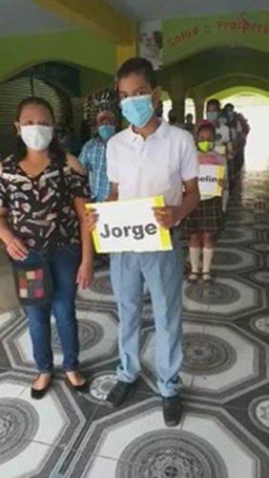
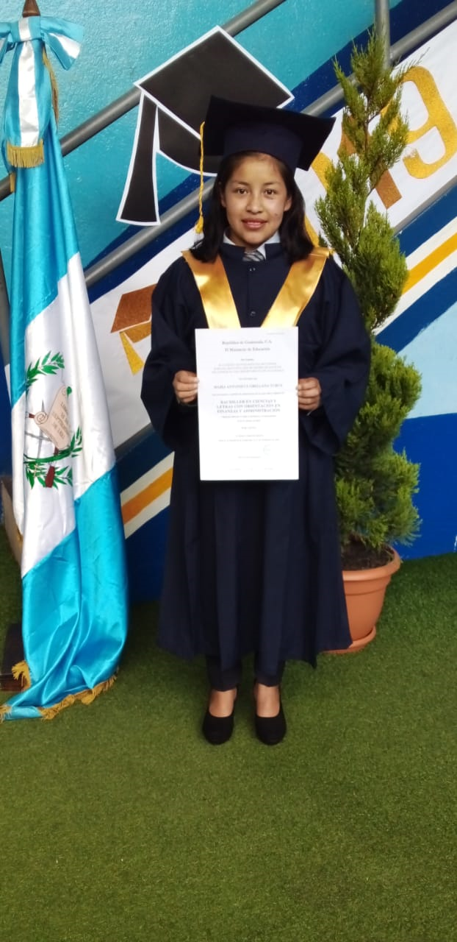
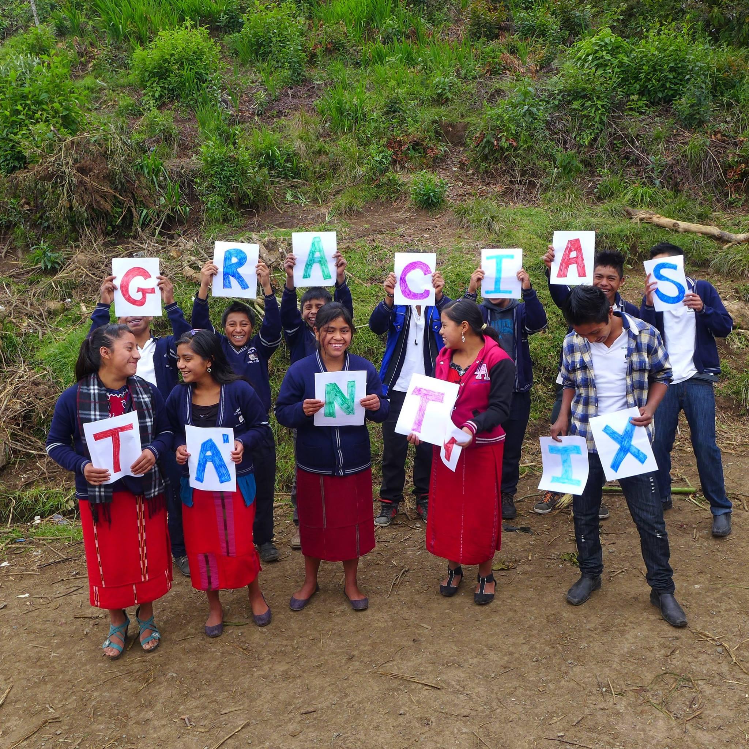
Questions & discussion
THANK YOU FOR YOUR SUPPORT!
Find Friends of Guatemala at
Fogrpcv.org
and Facebook

